Slide 1
Test Automation Pipelines Enabling Smoking Fast Feedback From Test Automation
Maciek Konkolowicz
http://macie-j.me
Software Quality Architect

Slide 2
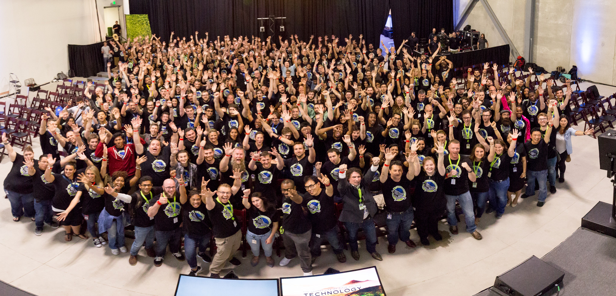
Notes:
Welcome, and thanks for coming! Today, I’d like to take you on a journey of how test automation delivery aided my team and how it can aid yours

Slide 3
Notes:
You’re probably asking yourself, is this talk for you? Well let’s find out by answering a few qualifying questions

Slide 4
Notes:
1. Is your team planning to write, or currently running functional automated tests? If you answered no then you are free to leave. If you answered yes, stay for more questions

Slide 5
Notes:
2. Next question: Do you know how to run one functional automated test yourself?

Slide 6
Notes:
Only a few more to go…Do you know how to run many automated tests whenever you want?

Slide 7
Notes:
Do you know how to run many automated tests, whenever you want, for different environments?

Slide 8
Notes:
Final question: Can you or any member of your team repeat runs of many test cases, for different environments, and receive quick results?

Slide 9
Push Button, get tests
Notes:
If you answered yes to all the questions I posed, then you are again, free to leave, because your quality champions are maintaining a very mature Quality process and you should be proud of your teams’ accomplishments.
But for the rest of you, let me tell you that you are not alone and that there is no to feel overwhelmed. My team was in the same situation.
We found ourselves answering no, about 3 years ago, when we started a serious functional test automation effort. We knew we wanted to get to a point where fast reliable feedback from functional test automation was a given. We wanted to get to a place where a Software Quality Engineer was not a bottle neck for test feedback, but an enabler of quality for the team. We stumbled, poked and engineered our way through a process which I am going to present to you today. I hope to convince you that the idea of the Test Automation Delivery Channel is a necessary and important endeavor which when followed will enable your team to achieve “push button, get test”.

Slide 10
Push Button: Get Test
Notes:
We found ourselves answering no, about 3 years ago, when we started a serious functional test automation effort.
We started with a series of half automated
We knew we wanted to get to a point where fast reliable feedback from functional test automation was a given. We wanted to get to a place where a Software Quality Engineer was not a bottle neck for test feedback, but an enabler of quality for the team. We stumbled, poked and engineered our way through a process which I am going to present to you today. I hope to convince you that the idea of the Test Automation Delivery Channel is a necessary and important endeavor which when followed will enable your team to achieve “push button, get test”.

Slide 11
Test Automation Pipeline Core Concepts
Notes:
The concept of a test delivery channel can be implemented in multiple testing environments, languages and for different product types. The first core idea is that a stable, easy to use, fast pipeline exists for executing and providing feedback from test automation.
The second core idea, is that this channel is established at the very early in a test automation effort. Early implementation of the channel allows for setup of the workflow which will force concentration on key concepts in test development, such as appropriate tests, stability and coverage, and prevent worrying about

Slide 12
Notes:
Speed (Short Feedback Scaled) *Year 1: No automation, pipeline created for Desktop product *Year 2: 500-1000 test cases in automation for Desktop product, pipeline created and scaled, time to run 500 test cases: 3 hours *Year 3: 1000-2000 test cases in automation for desktop product, time to run 1000 test cases: 3 hours, pipeline scaled out to handle *Current: 4000 test cases, multiple pipelines created in automation for desktop product, time to run 4000 test cases: 3.5 hours, pipelines scaled out to handle Team Involvement (Cross Functionality) *Year 1: No automation, test automation pipeline for desktop created *Year 2: UI Automation ran and designed by nightly runs and SQAs *Year 3: Pipeline created for integration tests, Integration tests ran automatically, designed and implemented by QAs and BAs, and Devs. Enabling Quality For Team Erika is a director on one of our teams. Although we have a shallow organizational structure, she is two levels below the CIO. In late August, she spotted a drop in our nightly runs for one of our teams. She raised the alarm bell right away, to the team lead, to the Quality Engineer who was already investigating the issue. This isolated incident is a perfect example of what we were striving for at the design of the automation process, which our Test Automation Pipeline enabled. Because our teams never focused on where to run automation, since we designed the pipelines at the beginning of our projects, they were able to focus on spreading quality to the entire team. Erika's team is a perfect example. Because the test automation channel was stable, she was able to rely on the results for consistent daily feedback after automatically triggered runs. The automation pipeline enabled our teams to turn on the flow of quality throughout our entire software development life cycle. In this presentation I have talked about the concept, it's components, benefits and shown an example of how to implement one. I hope that you go to your teams, and regardless of your role, begin implementing your own test automation pipeline, to raise your teams product quality. Thanks so much for your time and attention.

Slide 13
Notes:
T.A.D.C. Components
The purpose of the TADC is to provide fast, scalable feedback from the test automation it is executing. In order to do this, the channel is made up of two main parts that are connected together through configuration.

Slide 14
T.A.P. Components: Test Orchestrator
Notes:
Part 1: Test Orchestrator
A test orchestrator is a device which will automatically organize and execute your tests. A test orchestrator does not have to (but can) have a single responsibility. A test orchestrator is absolutely necessary because it is responsible for organizing how, and where your tests are executed. It is also the device which receives feedback from your tests and organizes them in a digestible way. Examples of popular test orchestrators include the "Test Controller" which is used in Microsoft's legacy "Test Manager/Lab Manager" testing infrastructure (See helpful link #1 below), Microsoft's Team Foundation Server (or Visual Studio Team Services) and The Jenkins Build System.

Slide 15
T.A.P. Components: Test Exe Environment
Notes:
Part 2: Test Execution Environment
A test execution environment is the set of machines or devices where your tests will run. It is the receiving end of the test automation delivery channel. The test execution environment receives tests from the test orchestrator, runs them and gives feedback to the test orchestrator about the test runs. The test environment should consist of many machines (which could be mobile devices too!) that will be able to run tests in parallel. The choice of which test execution environment depends on your team's needs

Slide 16
Notes:
So now that we know what a Test Automation Delivery Channel is, why we should have one, when to create it, and what it’s parts are, let’s take a look at how to create one.

Slide 17
Step 1: Pick A Test Orchestrator
Animated process flow picking orchestrator
Notes:
Step 1: Pick A Test Orchestrator
In the slides above we established that a test orchestrator is a device which will automatically organize and execute your tests, and provide a way to view feedback. We noted that Microsoft’s Test Manager , TFS, VSTS or Jenkins are all acceptable test orchestrator types. Other industry specific orchestrators such as Quality Center are also acceptable choices. When picking our team’s orchestrators, I found myself answering the following questions, which narrowed my choice down:
Can I Piggyback On To An Existing Product Which My Team Is Using?
If the answer is yes, I would just stick with this product. I prefer to re-purpose tools, and in the interest of causing as little adoption friction as possible, would suggest you do too. Change is hard, why introduce additional layers of complication?
Do I have Money To Spend?
If you do not have an already existing solution, do you have a budget? If you do not have limits, you can go all out and hire a consultant to implement the latest and greatest build system for you, which that consultant will then hook up for you and you can simply start writing tests to be executed in.
If you do not have money to spend, you have to resort to a free open source test orchestrator. Which is not a bad thing, it is just different than a paid tool.

Slide 18
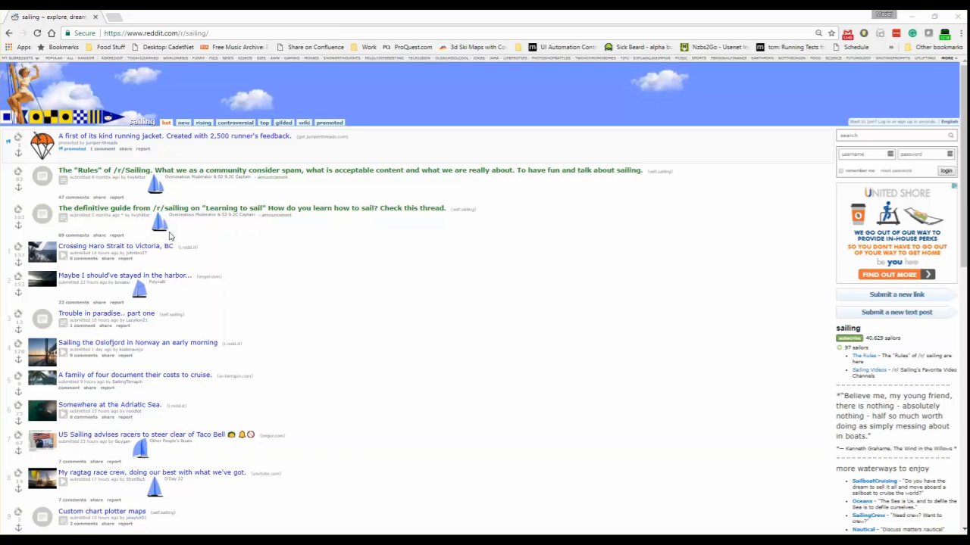
Our Choice: Existing Orchestrator
Notes:
My team was lucky enough to operate in an environment where TFS was already implemented, so we decided to stick to it. Also, because of this, for the purpose of this presentation, we are going to focus on the online version of TFS (VSTS) which is available for free use by small teams.

Slide 19
Step 2: Pick a Test Exe Environment
Animated process flow of picking a test environment
Notes:
A test execution environment is the set of machines or devices where your tests will run. The main decision point for picking this environment is what technology is your product operating in? Are you supporting a desktop application? A mobile product? A web app? You need to match your teste execution environment(s) to the products you are supporting.
Each technology stack can be supported by a series of different execution environments.
A test execution environment can be housed internally, or externally. Similarly to the Test Orchestrator, you have to ask yourself a few questions:
Do I have existing infrastructure I can use for testing?
Do I have money to spend on infrastructure for testing?
In this situation, I would suggest that offloading maintenance of environments is the best choice even if internal existing infrastructure exists. Treating infrastructure as a service will allow your team to focus on what their primary deliverable is: maintainable, scalable, appropriate tests.
If you are forced to use internal infrastructure (see next slide) you will want to ensure to minimize environmental variability.

Slide 20

Our Choices: Sauce, XTC and MTM
Notes:
Our team is responsible for maintenance of web, mobile, and desktop applications. For our Web presence we chose SauceLabs (and Selenium Grid), Xamarin Test Cloud and Microsoft Test Lab as our execution environment choices.
As noted, we tried to go with 3rd party environments for the purpose of scale, and to ensure our focus was on writing tests and figuring out scenarios, and not maintaining devices and VMs. Unfortunately, we had no choice but to do so with our desktop application.

Slide 21
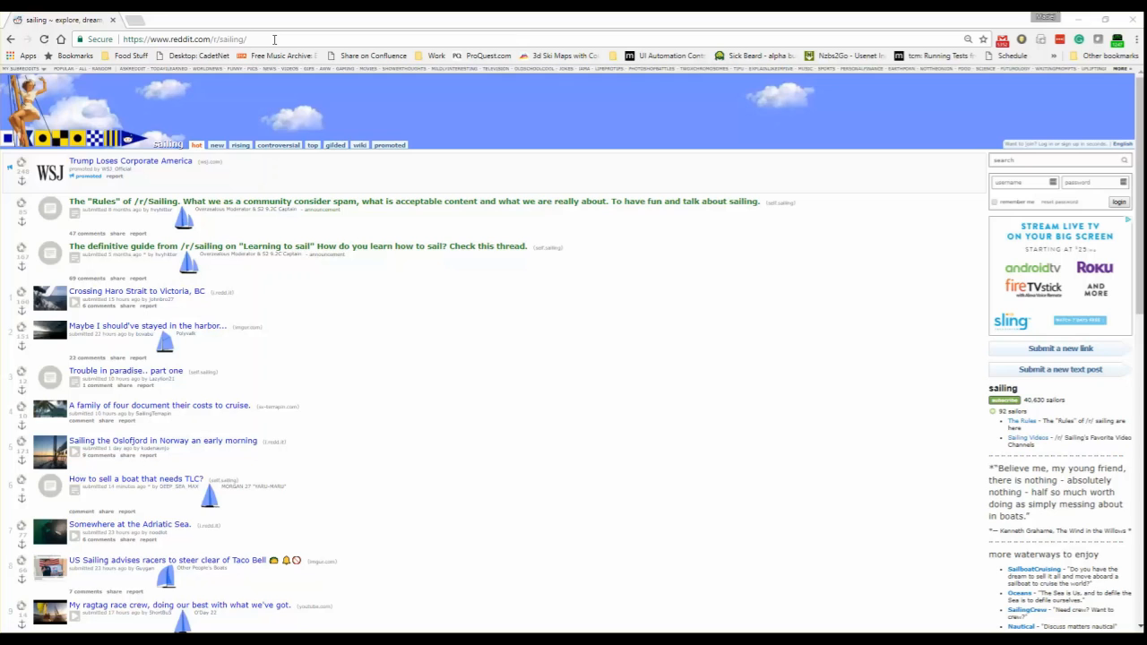
Our Choices: Sauce, XTC and MTM
Notes:
Our team is responsible for maintenance of web, mobile, and desktop applications. For our Web presence we chose SauceLabs (and Selenium Grid), Xamarin Test Cloud and Microsoft Test Lab as our execution environment choices.
As noted, we tried to go with 3rd party environments for the purpose of scale, and to ensure our focus was on writing tests and figuring out scenarios, and not maintaining devices and VMs. Unfortunately, we had no choice but to do so with our desktop application.

Slide 22
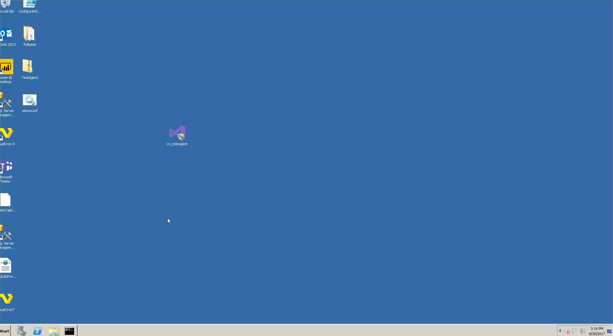
Our Choices: Sauce, XTC and MTM
Notes:
Our team is responsible for maintenance of web, mobile, and desktop applications. For our Web presence we chose SauceLabs (and Selenium Grid), Xamarin Test Cloud and Microsoft Test Lab as our execution environment choices.
As noted, we tried to go with 3rd party environments for the purpose of scale, and to ensure our focus was on writing tests and figuring out scenarios, and not maintaining devices and VMs. Unfortunately, we had no choice but to do so with our desktop application.

Slide 23
Step 3: Hook Up Your Components
Orchestrator To Lab Manager Hook Up Via VSTS (Add Machines)
Notes:
Once you pick your test orchestrator and execution environment, you will need to hook them up. The one thing which you absolutely cannot assume is communication between the execution environment and the test orchestrator. This is something which has to be confirmed as early as possible. In our environment, this is one of the larger hurdles we had to get over, due to infrastructure setup. The worst part of setting up the test automation channel was waiting for network infrastructure adjustments to allow communication from the test orchestrator to the test environment. It would be in the best interest of the test automation effort to get over this hurdle with at least one machine or device in the execution environment.

Slide 24
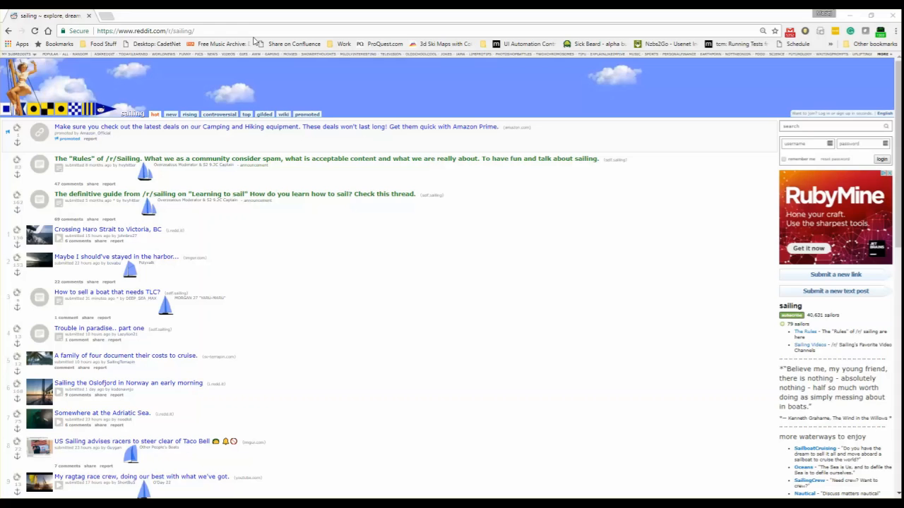
Our Setup: Adding Machines In TFS
Notes:
Note that videos of adding machines in Jenkins and TFS with SauceLabs can be found in the git repo.

Slide 25
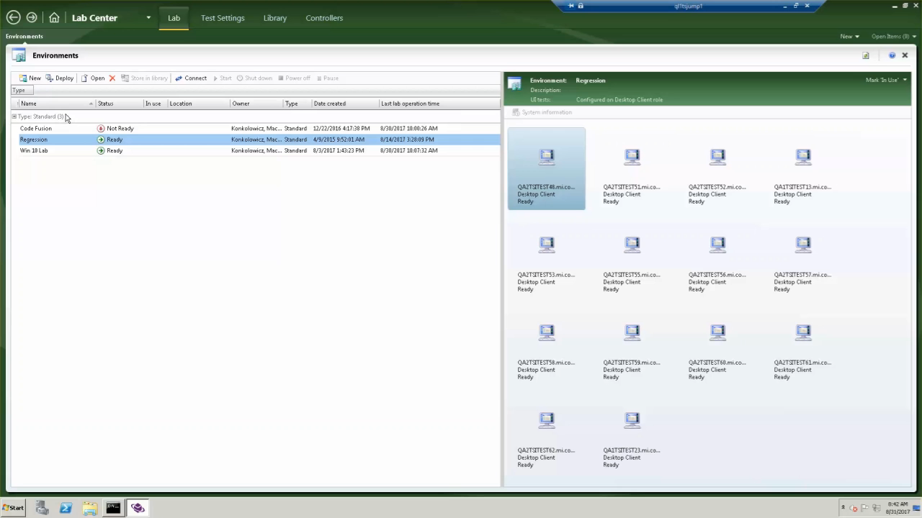
Our Setup: Adding Machines In TFS
Notes:
Note that videos of adding machines in Jenkins and TFS with SauceLabs can be found in the git repo.

Slide 26
Step 4: Define Your Trigger Strategy
Info graphic on the more frequent the runs the more analysis necessary
Notes:
Once you have decided your test orchestrator, execution environment and confirmed at least one device or machine in the execution environment can communicate with the test controller, it's time to define how often your tests will run. This decision is again specific to what your team needs, the execution time of your tests, and the cost for execution. Your trigger strategy should depend on how quickly your team needs to receive feedback from your test suite. Ideally, your test suite execution should align with your deployment strategy. The more frequently you deploy your product, the more frequently you should run your test suites to validate functionality

Slide 27
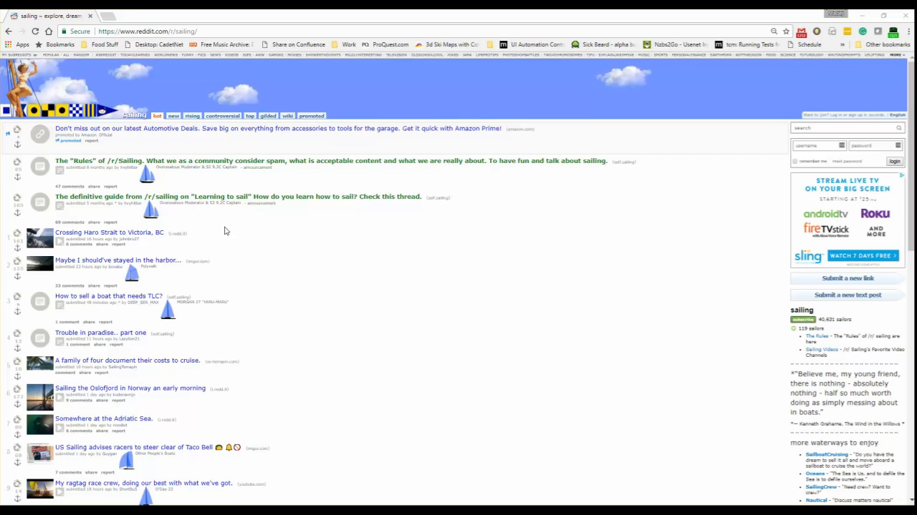
Our Setup: Nightly Automated Runs
Notes:
We setup nightly runs, because we have multiple pushes a day to our environments. Ideally, we would have multiple test runs, but realistically, daily feedback is fast enough for our teams, which operate in a two week cycle.

Slide 28
Step 5: Define Your Execution Steps
Notes:
Before we run tests, we have to think of any pre-requisite tasks that need to be executed. As with implementing the trigger strategy, this is fairly environment specific but worth talking about from a strategic perspective, since it takes some thought. One has to think about executing any pre-requisites necessary for a test run. It is best to assume that our environment will be barren, and we have to ensure anything which we will need to add for our product under test to work, will have to be copied in, installed, or injected in some other way. We also have to think about where our test code is coming from, and how it will be executed. In most situations that I've experienced, we pull test source code from a repository, and then compile it, before being able to execute it.
What pre-reqs are necessary for you to run tests in your environment?

Slide 29
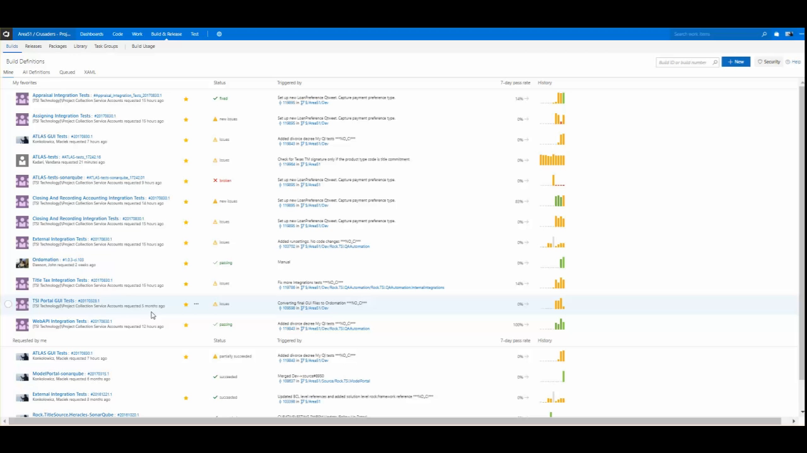
Our Setup: Build,Copy,Deploy,Run,Publish
Notes:
Notice there are many pre-requisite steps we have to follow to get the tests to run, including how to find the dlls.

Slide 30
Step 6: Educate Your Team
Blog Posts
Word Of Mouth
Regular Summaries
Dashboards
Notes:
The last piece in establishing a successful Test Automation Delivery Channel is probably the hardest. One of the biggest potential gains of test automation is its' ability to be executed and examined by folks who did not write it. The idea that a Business Analyst or Developer could use tests written by a Test Engineer to ensure quality is delivered for a feature change, allows a team to eliminate bottle necks and increase delivery speed. But in order to do this, they (your team) needs to be educated on how to run tests and analyze results.

Slide 31
Our Setup: Summary Emails
Notes:
On our team we have used nightly summary emails as megaphones for automation quality. As part of this quality communication we also talk about test automation delivery channel stability. If we see build failures or test run abortions, we communicate to the entire team and ask for folks to step up an

Slide 32
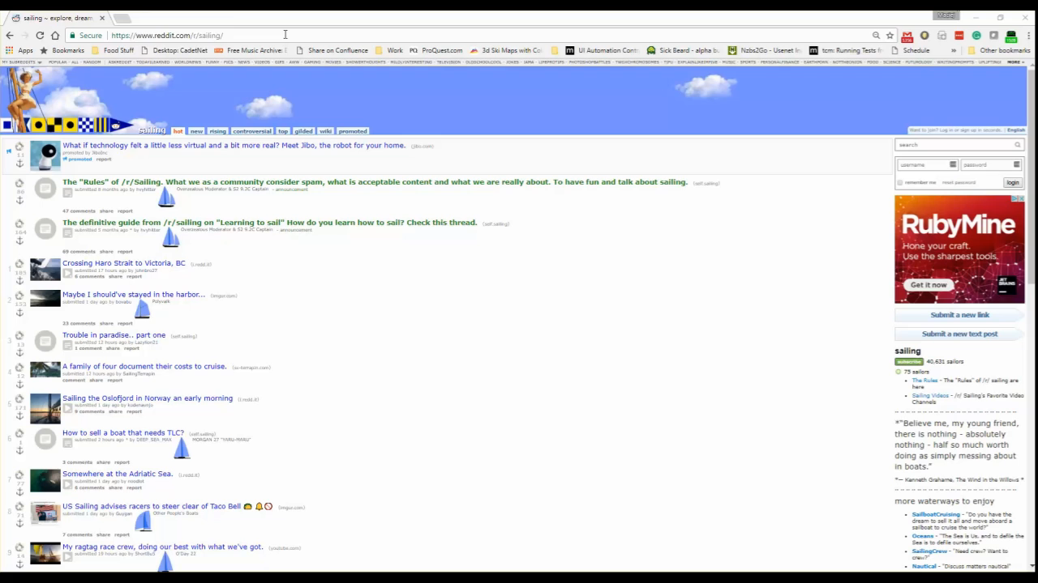
Our Setup: Dashboard
Notes:
This is an example of a dashboard. It gives the team the ability to drill in from a strategic perspective all the way to individual tests.

Slide 33
Results: How The T.A.P. Has Helped Us
Figures of how many tests we have run
Figures of who has ran the tests
Story of how Erika notices tests being executed
Notes:
Early setup of a Test Automation Delivery Channel really helped my team focus on writing tests that could be reliably executed, and scaled.
By designing and implementing the channel before focusing on producing a significant amount of tests, we ensured that when we did produce a significant amount of tests (thousands of them!), we were not worrying about why tests were not able to be executed or were not executing fast enough.
We have followed the above-outlined channel design process multiple times, and each time found that it enabled us to focus on figuring out what to test, instead of how to run tests.

Slide 34
Notes:
3 years ago we started a journey which led us to our present automation state that we are really proud of. We started with one automation engineer writing scripts for the entire team on his machine. We had three or four half automated scripts. Today our entire cross functional team makes use of our testing infrastructure. Bas, Devs and QA execute tests whenever necessary. We have nightly execution runs of approximately 2100 functional automated scripts across web, desktop and mobile environments and are constantly adding, removing and improving our suite. I believe the only way we could focus on adding, refactoring and improving our scripts, is through the focus we are able to achieve and the bottlenecks we’ve eliminated in our Test Automation Delivery Channel. I hope I have convinced you that a Test Automation Delivery Channel is a process which every team interested in test automation absolutely has to figure out and the examples I have provided will make this easier for you and your team. Thank you, and now I will take some questions.

Slide 35
T.A.P.: Enabling Our Quality Success Story
Notes:
1. Focus on Test Automation Pipeline: Speed (Short Feedback Scaled) *Year 1: No automation, pipeline created for Desktop product *Year 2: 500-1000 test cases in automation for Desktop product, pipeline created and scaled, time to run 500 test cases: 3 hours *Year 3: 1000-2000 test cases in automation for desktop product, time to run 1000 test cases: 3 hours, pipeline scaled out to handle *Current: 4000 test cases, multiple pipelines created in automation for desktop product, time to run 4000 test cases: 3.5 hours, pipelines scaled out to handle Team Involvement (Cross Functionality) *Year 1: No automation, test automation pipeline for desktop created *Year 2: UI Automation ran and designed by nightly runs and SQAs *Year 3: Pipeline created for integration tests, Integration tests ran automatically, designed and implemented by QAs and BAs, and Devs. Enabling Quality For Team Erika is a director on one of our teams. Although we have a shallow organizational structure, she is two levels below the CIO. In late August, she spotted a drop in our nightly runs for one of our teams. She raised the alarm bell right away, to the team lead, to the Quality Engineer who was already investigating the issue. This isolated incident is a perfect example of what we were striving for at the design of the automation process, which our Test Automation Pipeline enabled. Because our teams never focused on where to run automation, since we designed the pipelines at the beginning of our projects, they were able to focus on spreading quality to the entire team. Erika's team is a perfect example. Because the test automation channel was stable, she was able to rely on the results for consistent daily feedback after automatically triggered runs. The automation pipeline enabled our teams to turn on the flow of quality throughout our entire software development life cycle. In this presentation I have talked about the concept, it's components, benefits and shown an example of how to implement one. I hope that you go to your teams, and regardless of your role, begin implementing your own test automation pipeline, to raise your teams product quality. Thanks so much for your time and attention.

